Slide 1

Experiment 4
Water level measurement
with Ultrasonic

Slide 2
Arduino Overview and Programming Guide
Why Use Arduino?
Arduino is an easy-to-use electronics platform that is suitable for all skill levels, and it offers the following benefits:
Easy to Use: Designed for both beginners and professionals.
Open Source: Both hardware and software are open-source, meaning anyone can use and modify them.
Versatile: Can be used for a wide range of projects, from simple to complex ones.
Large Community: A large community that provides support, resources, and tutorials.
Arduino Board Components
Microcontroller: The "brain" of the board that executes the program.
Digital Pins: Used for digital input and output (HIGH or LOW).
Analog Pins: Used for reading analog signals and converting them into digital values.
Power Pins: Used to supply power to the board and external components.
Arduino Code Structure

Slide 3
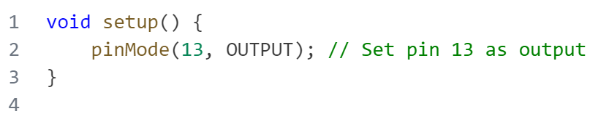
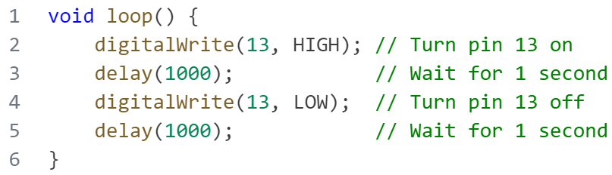
Arduino Overview and Programming Guide
Arduino Code Structure
Arduino code consists of two main functions:
setup()
Runs once at the beginning of the program.
Used to initialize the setup, such as
setting pin modes.
loop()
Runs repeatedly after the setup() function.
Contains the main tasks that the program
will perform.

Slide 4
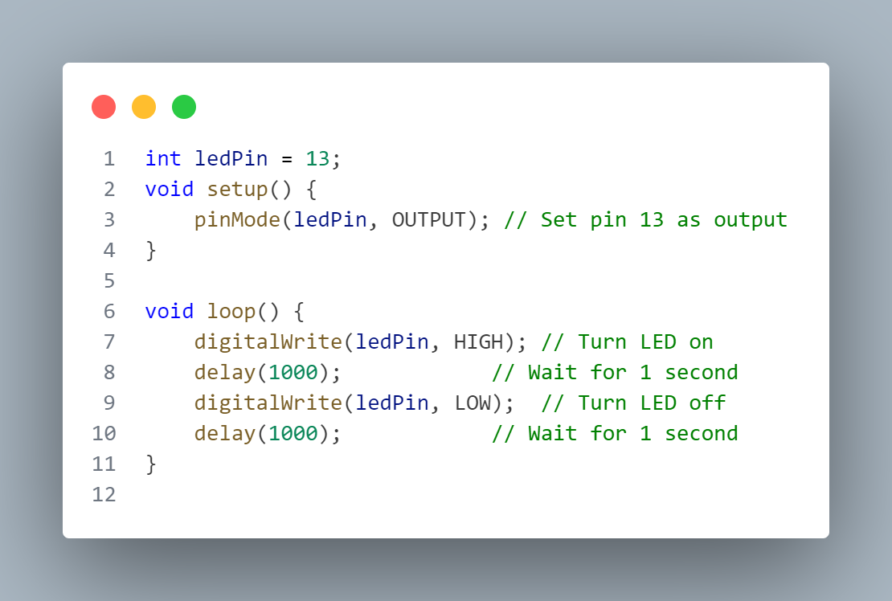
—SOMEONE FAMOUS
Arduino Overview and Programming Guide
Basic Arduino Functions
pinMode(pin, mode): Used to set the pin mode as input (INPUT) or output (OUTPUT).
digitalRead(pin): Reads the state of a digital pin (HIGH or LOW).
digitalWrite(pin, value): Sets the state of a digital pin (HIGH or LOW).
Example 1 - Blinking LED
Objective:
Make an LED blink on and off repeatedly.
Components: Arduino board – LED
Resistor (220 ohms) – Breadboard - Jumper wires.
Steps:
Connect the LED to a digital pin (pin 13)
Connect the other leg of the LED to ground (GND).
Upload the following code to the Arduino.

Slide 5
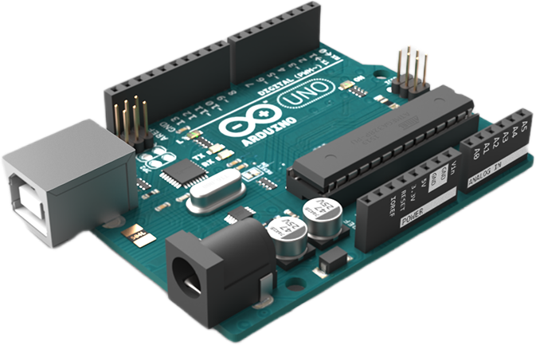
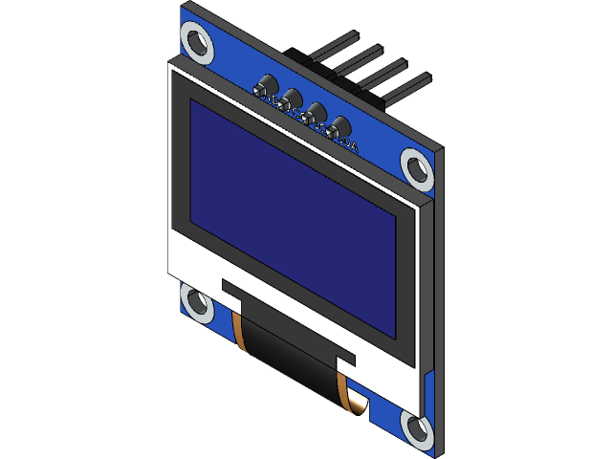
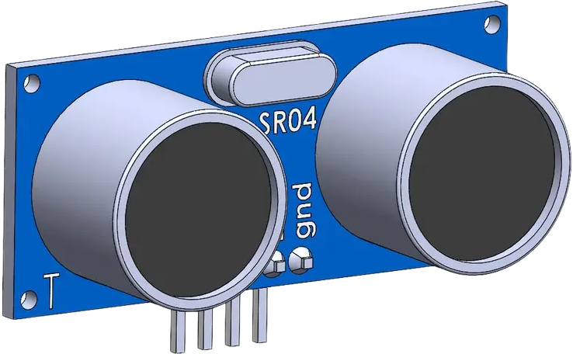
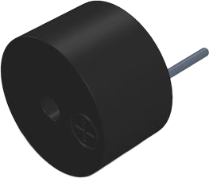
—SOMEONE FAMOUS
Project: Water level measurement with ultrasonic
In this project, Measure water levels in a tank using an ultrasonic sensor. Display the level on an OLED display and activate a buzzer if the water level exceeds a predefined threshold.
01
Arduino board
03
OLED Display
02
UltraSonic Sensor
05
Buzzer

Slide 6
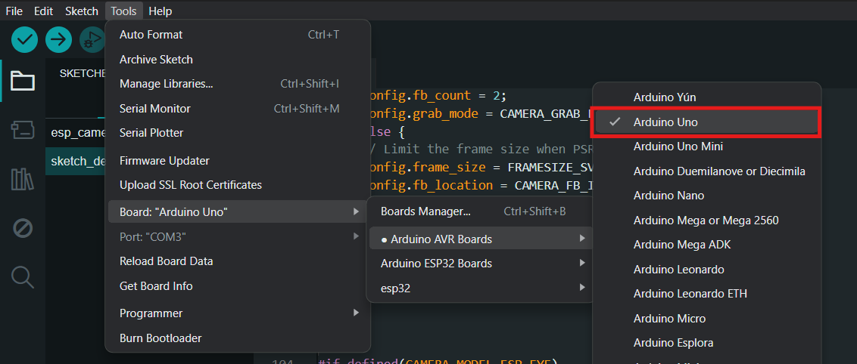
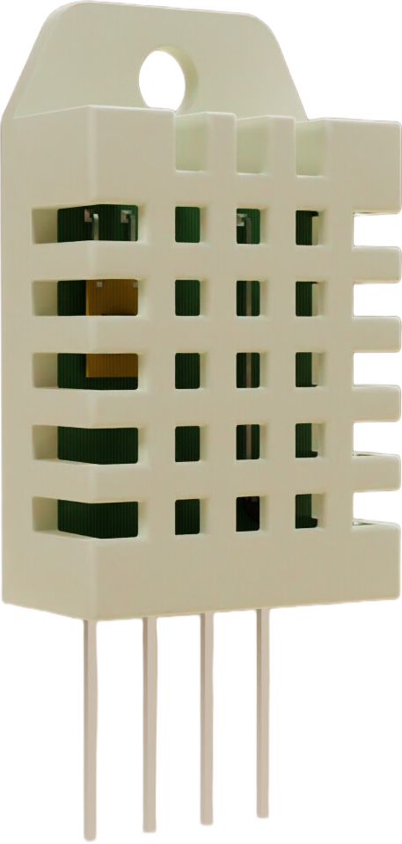
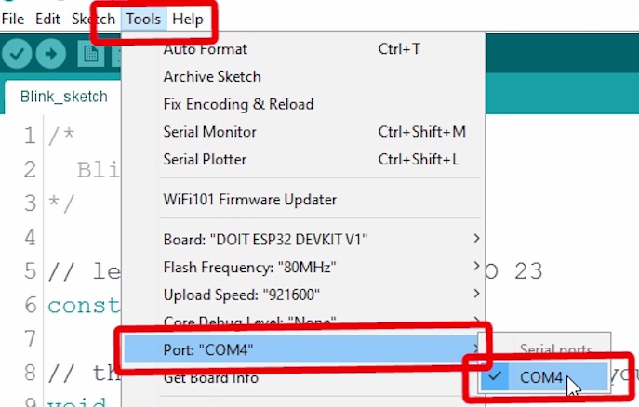
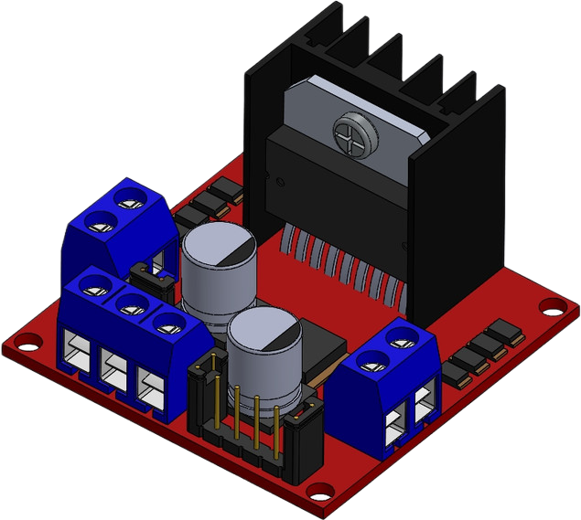
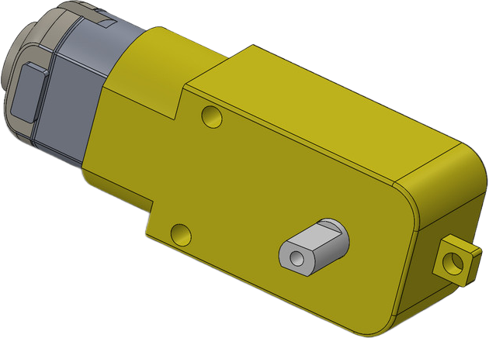
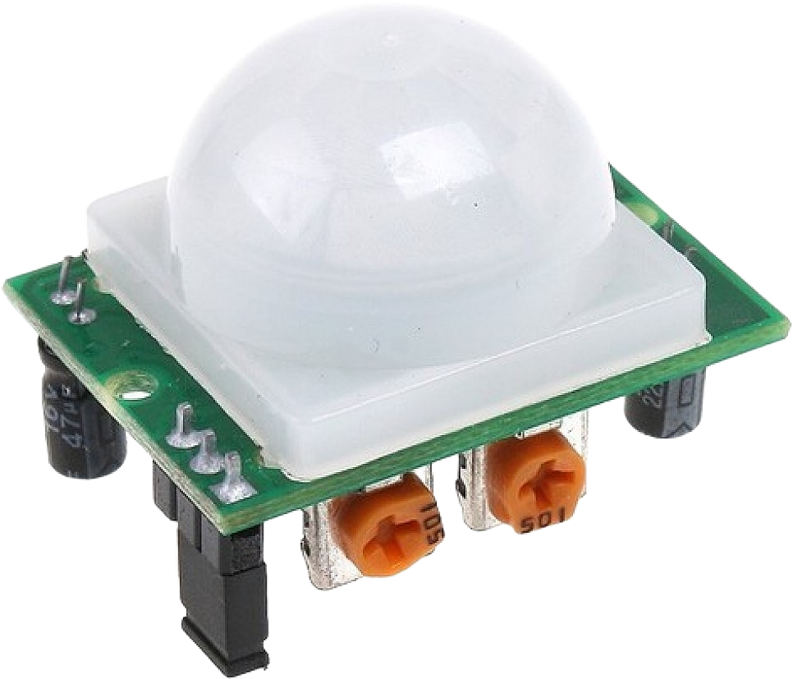
—SOMEONE FAMOUS
Project: DC Motor Control with Motion Sensor Through ESP32
01
Ardiuno Uno
In this project, we will control a DC motor based on the input from a motion sensor (PIR sensor) using an ESP32 board. When motion is detected by the PIR sensor, the DC motor will be activated, and it will stop once the motion is no longer detected.
Select your Board in Tools > Board menu
(in my case it’s the Arduino Uno)
Select the Port (if you don’t see the COM Port in your Arduino IDE, you need to install the CP210x USB to UART Bridge VCP Drivers):
02
UltraSonic Sensor
04
L298N Motor Driver
02
DC Motor
05
PIR Motion Sensor

Slide 7
04
02
UltraSonic Sensor
The Ultrasonic Sensor is used to measure distance by emitting ultrasonic waves and calculating the time taken for the waves to return after reflecting off an object. It operates using the principle of sound wave propagation and has the following key components:
Pins:
VCC: Supplies power to the sensor (5V).
GND: Common ground.
Trig: Trigger pin to send an ultrasonic pulse.
Echo: Echo pin to receive the reflected pulse.
OLED Display
03

Slide 8
02
04
OLED Display
The OLED Display is used to visually represent text, images, or graphics. It operates using organic light-emitting diodes for high contrast and low power consumption and has the following key components:
Pins:
VCC: Supplies power to the display (3.3V or 5V,depending
on the model).
GND: Common ground.
SCL : Serial clock line for communication.
SDA : Serial data line for transferring data to the display.
05
Buzzer

Slide 9
04
05
Buzzer
02
The Buzzer is used to produce sound or alert signals in electronic circuits.
It operates by converting electrical energy into sound and can be active (generates sound automatically) or passive (requires an external signal).
Pins:
VCC: Supplies power to the buzzer (typically 3.3V or 5V).
GND: Common ground.

Slide 10
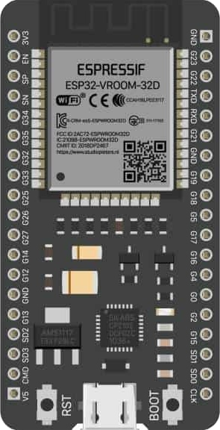
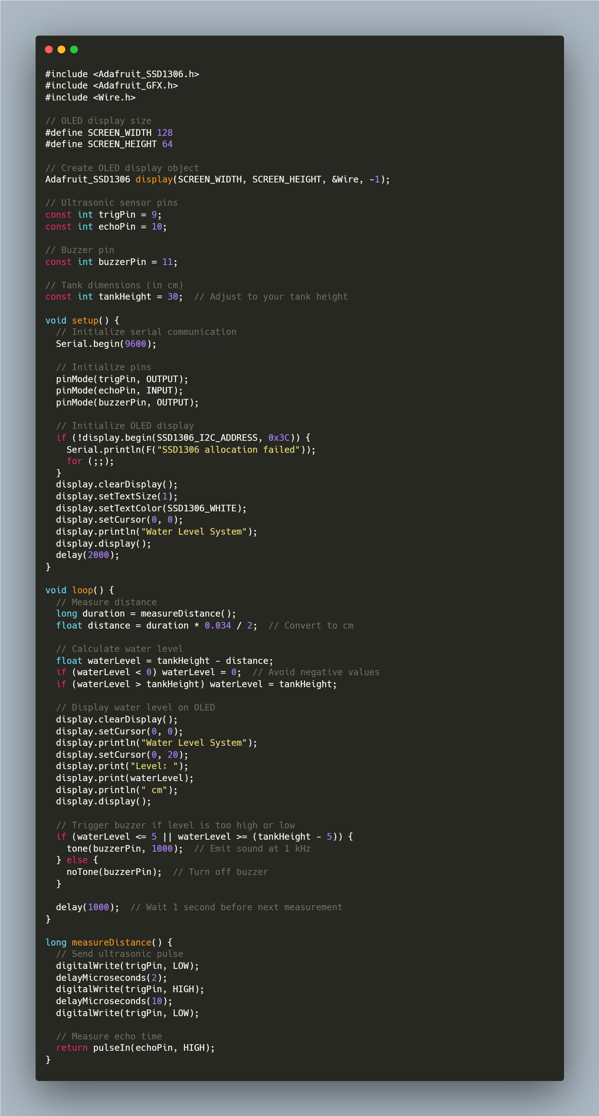
—SOMEONE FAMOUS
01
Project: DC Motor Control with Motion Sensor Through ESP32
ESP32 board
DC Motor
05
PIR Motion Sensor

Slide 11
—SOMEONE FAMOUS
01
Project: DC Motor Control with Motion Sensor Through ESP32
ESP32 board
DC Motor
05
PIR Motion Sensor

Slide 12
Thank You

